Slide 1
Measuring Spin-Polarizabilities of the Proton in Polarized Compton Scattering at MAMI-Mainz
Rory Miskimen
University of Massachusetts, Amherst
for the Mainz A2 Collaboration
Chiral Dynamics 2012
Compton scattering and nucleon spin-polarizabilities
First measurements of double-polarized Compton scattering asymmetries on the proton

Slide 2
Measuring nucleon spin-polarizabilities in polarized Compton scattering
At O(ω³) four nucleon structure terms involving nucleon spin-flip operators enter the Real Compton Scattering expansion.
Spin polarizabilities tell us about the response of the nucleon spin to the photon polarization.
The “stiffness” of the spin can be thought of as arising from the nucleon’s spin interacting with the pion cloud.

Slide 3
Experiments
The GDH experiments at Mainz and ELSA used the Gell-Mann, Goldberger, and Thirring sum rule to evaluate the forward S.-P. γ₀
Backward spin polarizability from dispersive analysis of backward angle Compton scattering
The pion-pole contribution has been subtracted from γ_{π}

Slide 4
Proton spin-polarizability measurements and predictions in units of 10⁻⁴ fm⁴
 | O(p³) | O(p⁴) | O(p⁴) | LC3 | LC4 | SSE | BGLMN | HDPV | KS | DPV | ΔΤheory | Experiment
γ_{E1E1} | -5.7 | -1.4 | -1.8 | -3.2 | -2.8 | -5.7 | -3.4 | -4.3 | -5.0 | -4.3 | 4.3 | No data
γ_{M1M1} | -1.1 | 3.3 | 2.9 | -1.4 | -3.1 | 3.1 | 2.7 | 2.9 | 3.4 | 2.9 | 6.5 | No data
γ_{E1M2} | 1.1 | 0.2 | .7 | .7 | .8 | .98 | 0.3 | -0.01 | -1.8 | 0 | 2.9 | No data
γ_{M1E2} | 1.1 | 1.8 | 1.8 | .7 | .3 | .98 | 1.9 | 2.1 | 1.1 | 2.1 | 1.8 | No data
γ₀ | 4.6 | -3.9 | -3.6 | 3.1 | 4.8 | .64 | -1.5 | -.7 | 2.3 | -.7 |  | -1.01 ±0.08 ±0.10
γ_{π} | 4.6 | 6.3 | 5.8 | 1.8 | -.8 | 8.8 | 7.7 | 9.3 | 11.3 | 9.3 |  | 8.0± 1.8†
Calculations labeled O(p^{n}) are ChPT
LC3 and LC4 are O(p³) and O(p⁴) Lorentz invariant ChPT calculations
SSE is small scale expansion
Other calculations are dispersion theory

Slide 5
Polarization observables in real Compton scattering
Circular polarization
Circular polarization
Linear polarization

Slide 6
Polarization observables in real Compton scattering
Circular polarization
Circular polarization
Linear polarization

Slide 7
Polarization observables in real Compton scattering
Circular polarization
Circular polarization
Linear polarization

Slide 8
Polarization observables in Compton scattering
Circular polarization
Circular polarization
Linear polarization

Slide 9
Dispersion Model for RCS and VCS†
γ∗
γ
γ∗
π
γ
Im
=
N
N
N
N
Connects pion electroproduction amplitudes from MAID with VCS
Unconstrained asymptotic contributions to two of the 12 VCS amplitudes are fit to the data. Valid up to
Enhanced sensitivity to the polarizabilities
†B. Pasquini, et al., Eur. Phys. J. A11 (2001) 185, and D. Drechsel et al., Phys. Rep. 378 (2003) 99.

Slide 10
Sensitivity Study for Σ_{2x}
Vary α, β, γ₀ and γ_{π} within experimental error bars, and
vary γ_{E1E1} holding γ_{M1M1} fixed, or
vary γ_{M1M1} holding γ_{E1E1} fixed
E_{γ} = 280 MeV
Δγ_{E1E1} = ±1
Δγ_{M1M1} = ±1
Σ_{2x}
Σ_{2x}

Slide 11
Polarization observables in real Compton scattering
Circular polarization
Sensitive to γ_{E1E1}
Circular polarization
Sensitive to γ_{M1M1}
Linear polarization
Sensitive to γ_{E1E1} and γ_{M1M1}

Slide 12
Measurements of Σ_{2x} at MAMI-Mainz
Circular polarization
Sensitive to γ_{E1E1}
Phil Martel’s Ph.D. thesis, UMass Amherst

Slide 13
E_{γ} ≈ 280 MeV (large sensitivity spin-polarizabilities)

Slide 14
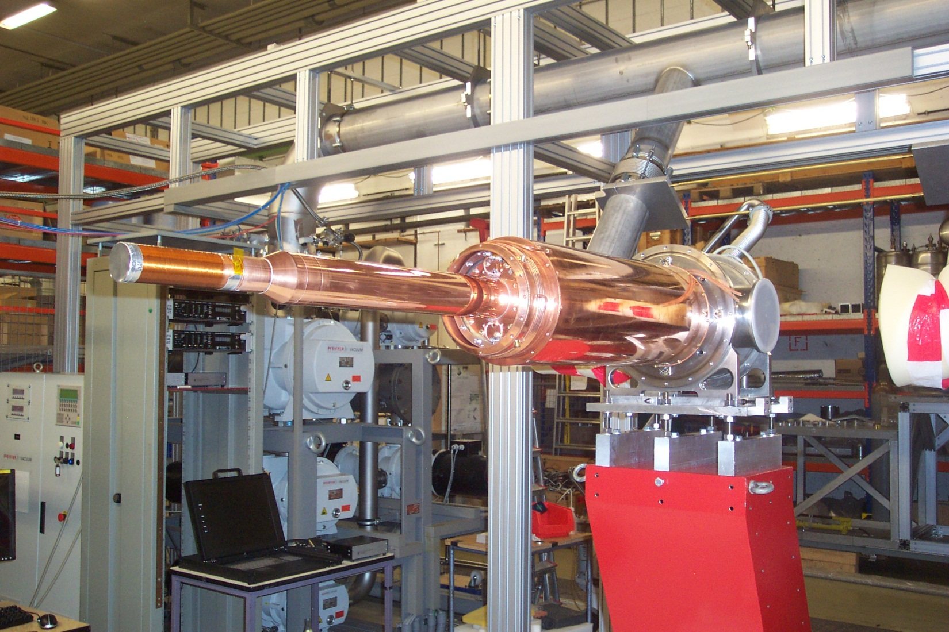
Frozen spin target
2 cm butanol
target polarized at 25 mK
0.6 T holding field
P ~ 90%
> 1000 hours relaxation time

Slide 15
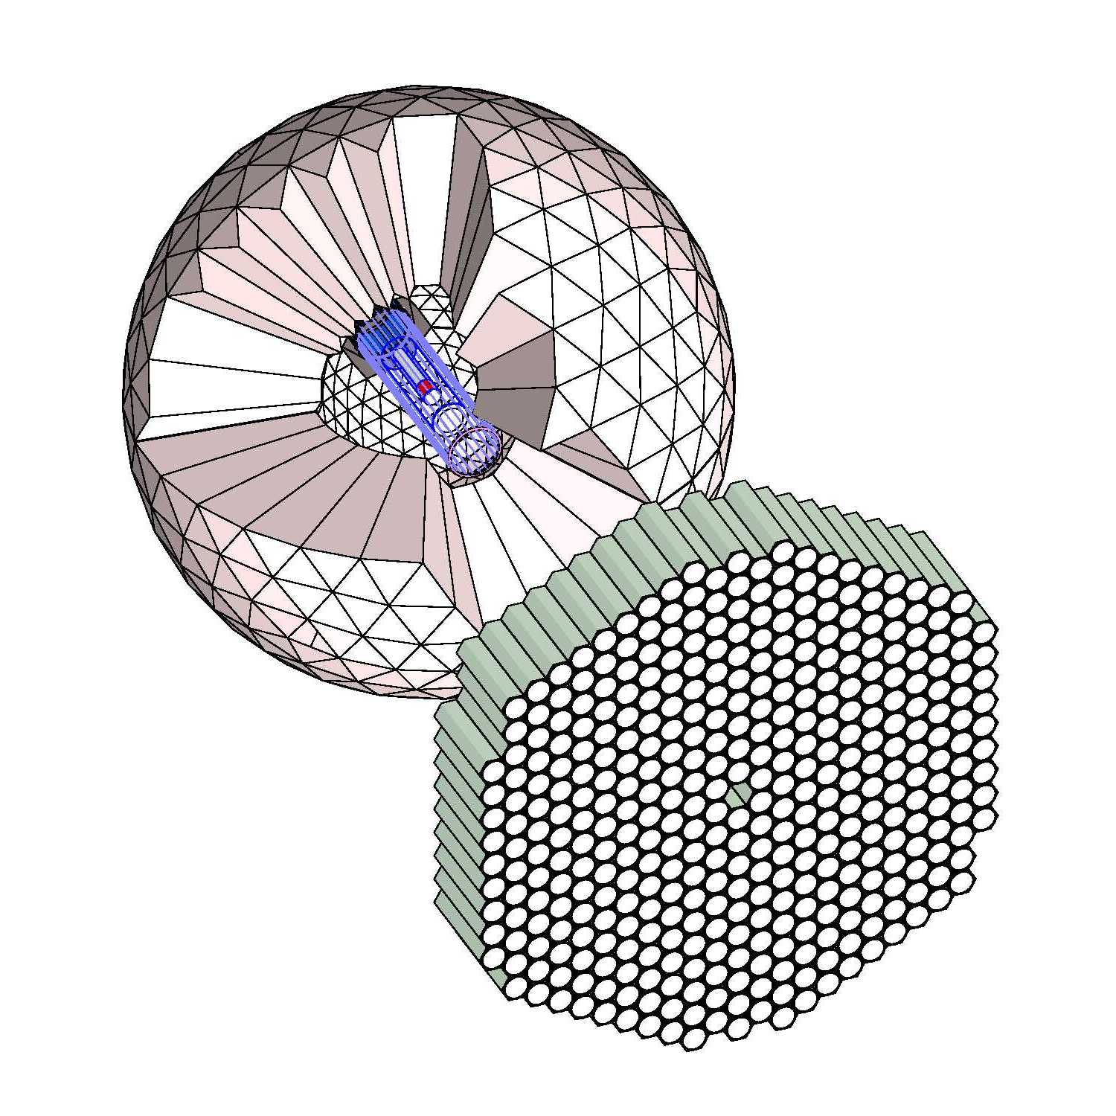
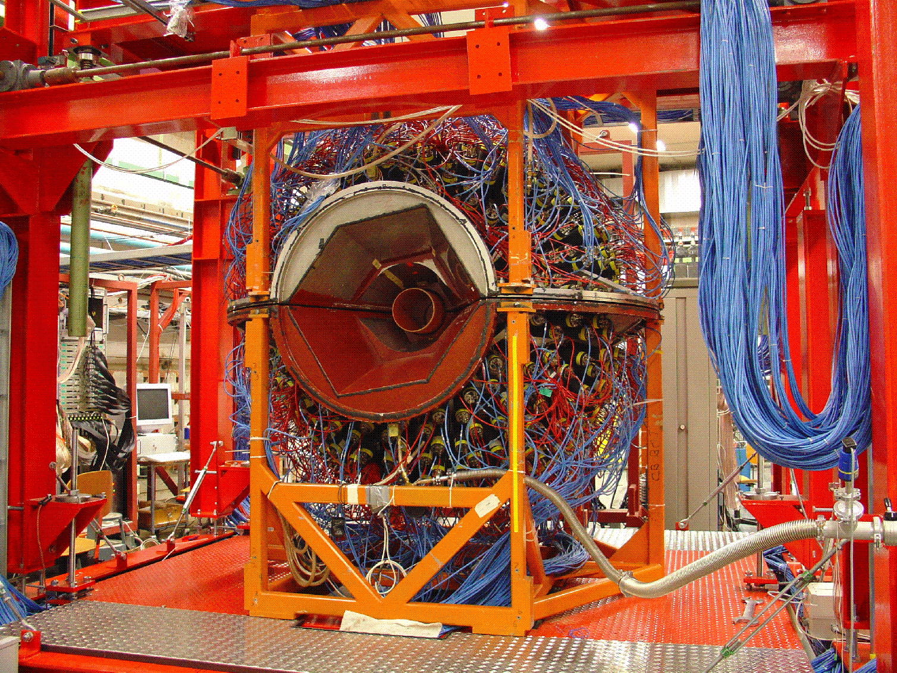
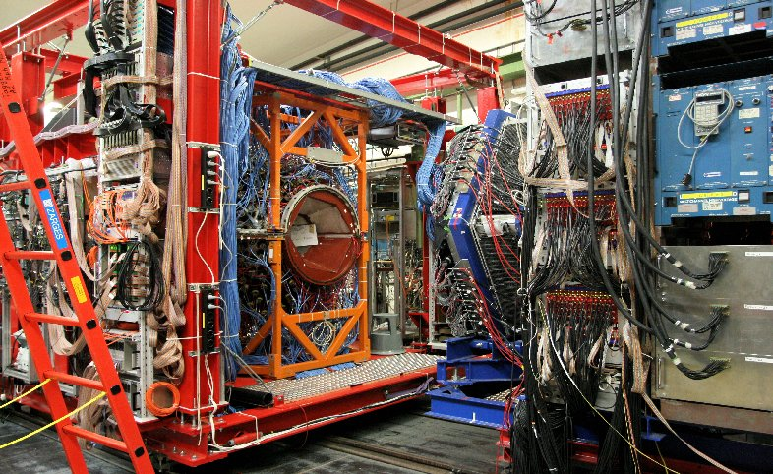
Crystal Ball and TAPS
≈ 4π photon detection, 4° < θ < 160°
CB: 672 NaI crystals, ΔE~3%, Δθ~2.5°
TAPS: 366 BaF₂ and 72 PbW0₄ crystals ΔE~5%, Δθ~0.7°

Slide 16
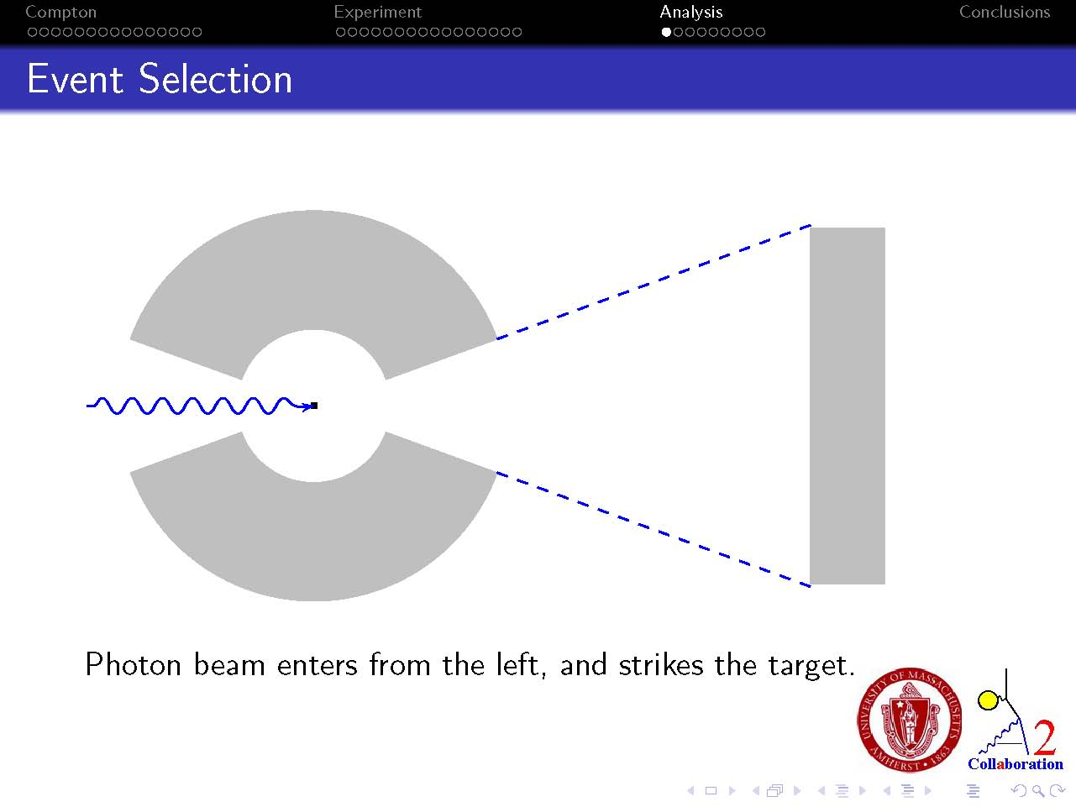
Crystal Ball
TAPS
cylindrical WC
scintillators

Slide 17
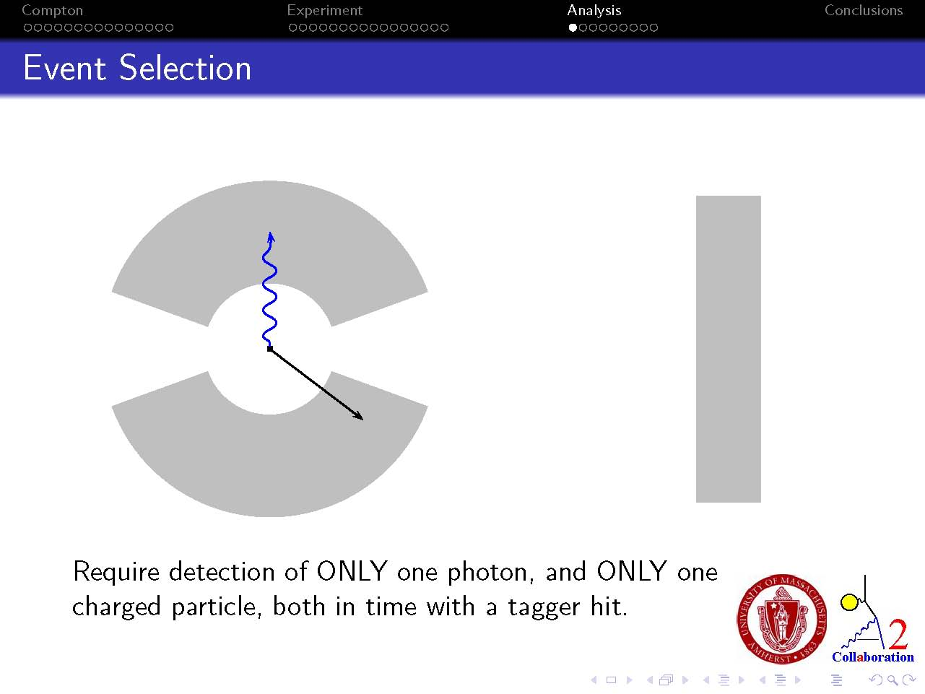
Crystal Ball
TAPS

Slide 18
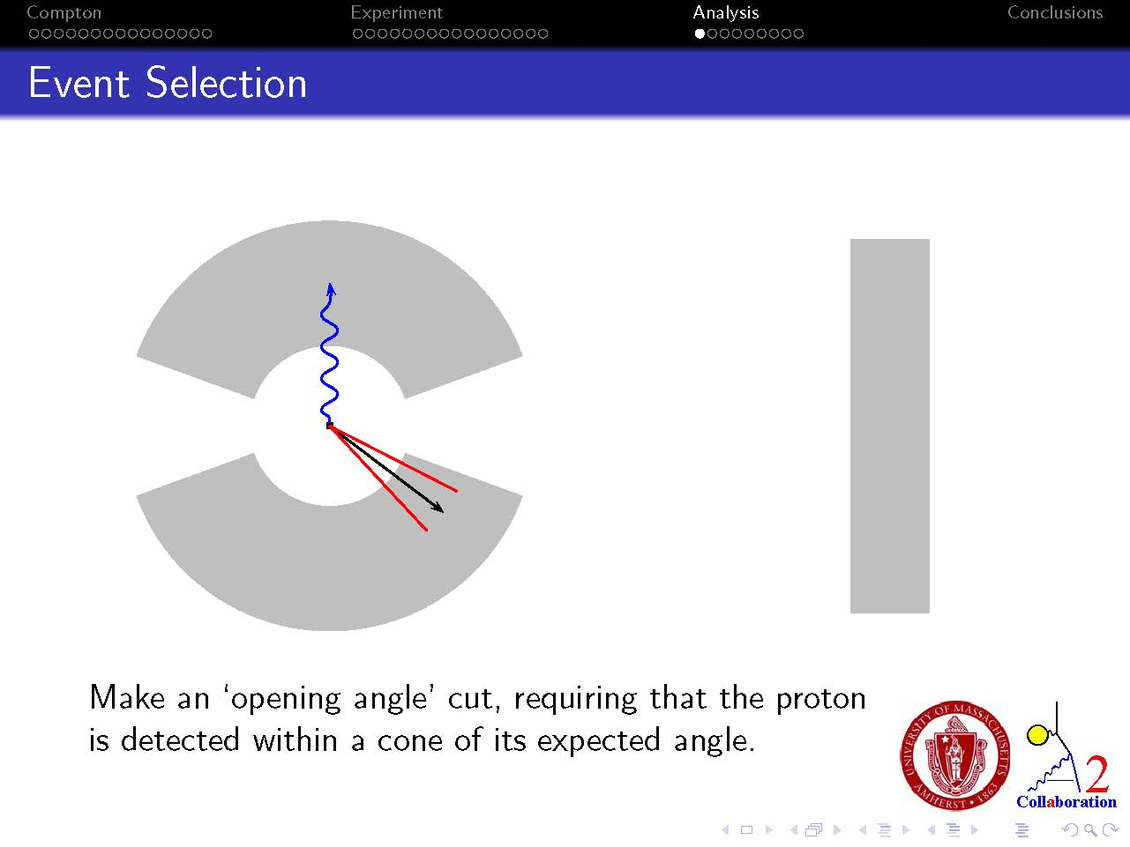
Crystal Ball
TAPS

Slide 19
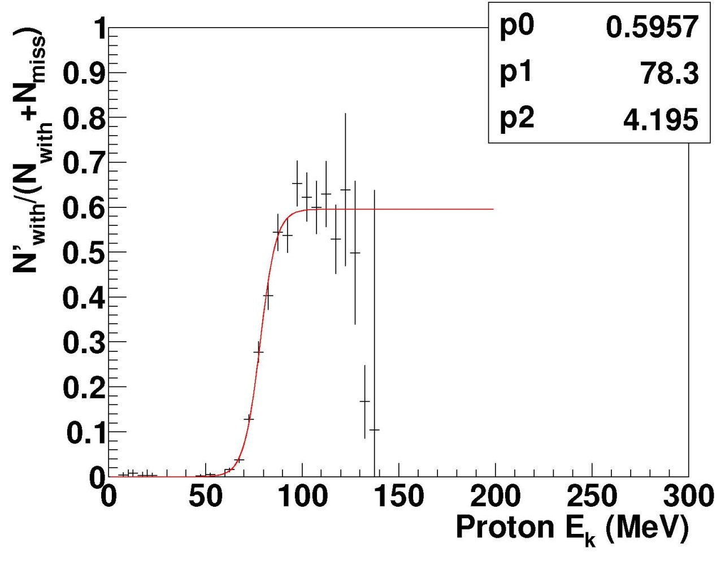
Proton detection efficiency measured in the γp → π⁰ p reaction
Peak efficiency ~60%
Low energy cutoff ~ 75 MeV

Slide 20
Signal and Background Reactions
Require only two tracks in the detector, one neutral and one charged, and
require correct opening angle between Compton scattered photon and charged track, and co-planarity
Proton Compton
Proton π⁰
Coherent π⁰
Coherent Compton
Incoherent Compton
Incoherent π⁰

Slide 21
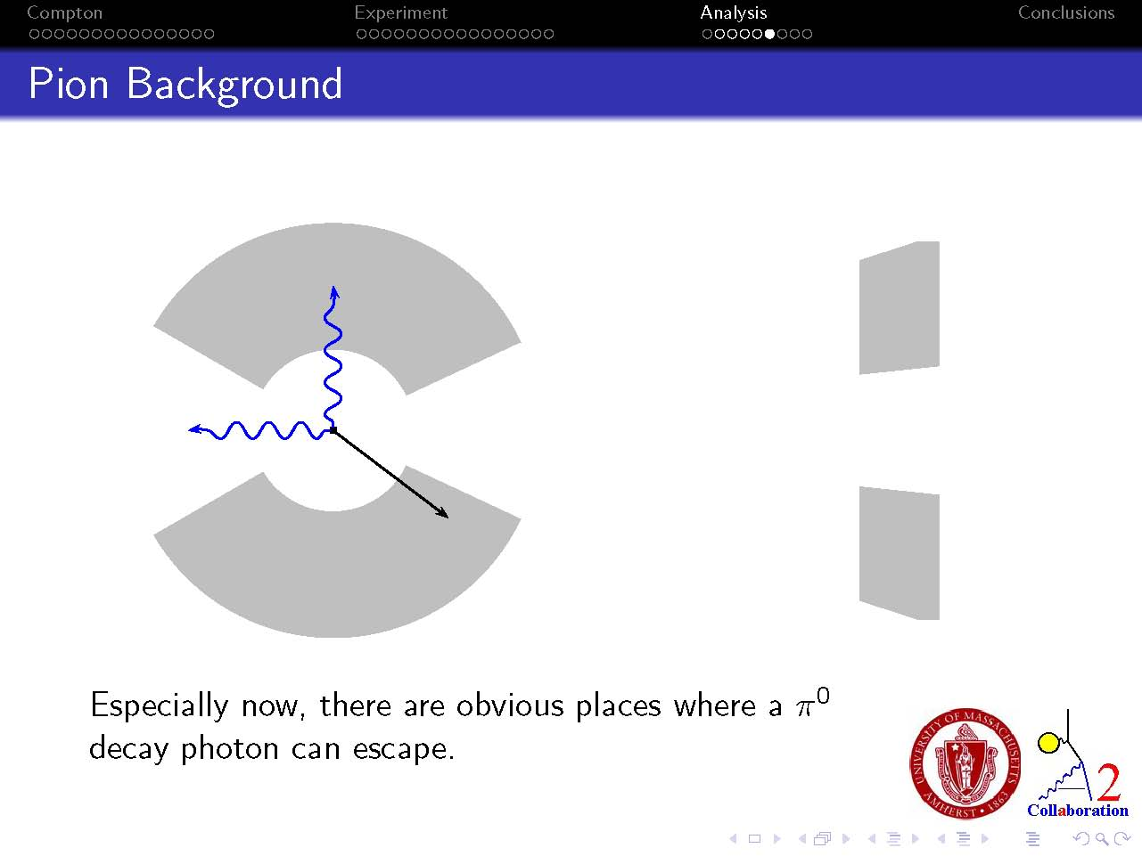
Crystal Ball
TAPS

Slide 22
Yield on butanol
Background
Compton peak

Slide 23
Yield on butanol
Background
Compton peak
Yield on carbon

Slide 24
Carbon subtracted
Background
Compton peak

Slide 25
Carbon subtracted
Background
Compton peak
π⁰ photon goes down beampipe

Slide 26
Carbon subtracted
Background
Compton peak
π⁰ photon goes up beampipe

Slide 27
Carbon subtracted
Background
Compton peak
π⁰ photon goes between CB and TAPS

Slide 28
π⁰ subtracted
Background
Compton peak

Slide 29
Integrate

Slide 30
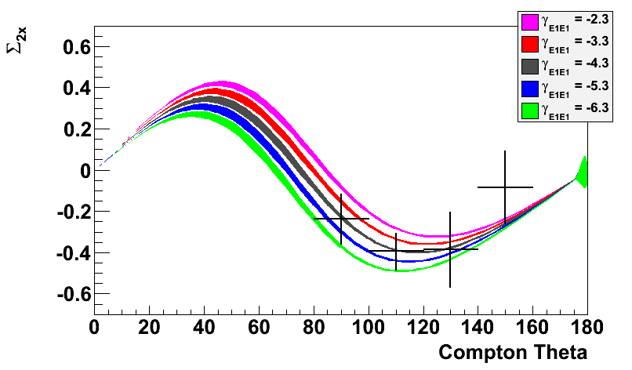
Asymmetry with transverse polarized target and circularly polarized photons
E_{γ}~ 285 MeV
PRELIMINARY
Σ_{2x}
Changing γ_{E1E1}

Slide 31
Summary
First measurement of a double-polarized Compton scattering asymmetry on the nucleon, Σ_{2x}
Data have sensitivity to the γ_{E1E1} spin-polarizability
Outlook
Data taking on Σ₃ later this year at MAMI ( for γ_{E1E1} and γ_{M1M1} )
Data taking on Σ_{2z} in 2013 ( for γ_{M1M1} )
A global analysis of all polarized Compton scattering data on the proton using dispersion analysis treatment is in progress
Development of an active polarized target has been approved for MAMI. Polarizable scintillators have been developed at UMass.

Slide 33

Measuring the spin polarizabilities of the proton in double-polarized Compton scattering at Mainz: PRELIMINARY results from P. Martel (Ph.D. UMass)
Transverse target asymmetry Σ_{2x} and sensitivity to γ_{E1E1}
Frozen spin target
PRELIMINARY
Crystal Ball

Slide 34
Σ_{2x} asymmetry: transverse polarized proton target, circularly polarized photons
Changing γ_{M1M1}

Slide 35
Have used a very conservative cut on the missing mass spectrum, E < 930 MeV
Use monte carlo constrained Compton scattering peak-shapes to extract yields
Integrate
Monte carlo simulation of Compton scattering peak-shape

Slide 36
Proton spin polarizability
π+
Rotating electric field induces pion current. Lorentz force moves pion orbit outward
Spin polarizability: “Pionic” Faraday effect

Slide 37
Proton spin polarizability
π+
Rotating electric field induces pion current. Lorentz force moves pion orbit inward
Spin polarizability: “Pionic” Faraday effect

